Slide 1
Project 1: Controlled Evalbot Movement Design Review
EECS 690: Advanced Embedded Systems
Nilisha Mane, Cassandra Post, Monica Shafii

Slide 2
Overview
The Evalbot
Stage 1 Goals
Testing the Results
Design Overview

Slide 3
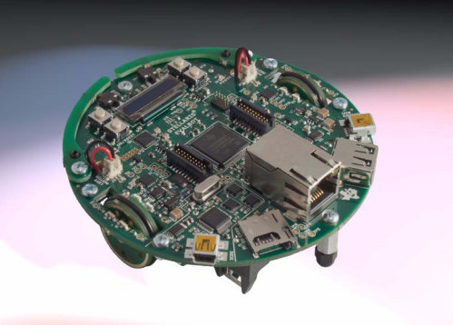
Stellaris® LM3S9B92 EVALBOT Robotic Evaluation Board (EVALBOT)
Source for image: http://www.ittc.ku.edu/~gminden/Embedded_Systems/PDFs/TI_Stellaris_LM3S9B92_EVALBOT_UM.pdf

Slide 4
Stage 1 Goals
(Wired) EVALBOT will move across the desk in the Eaton Lab in a controlled fashion.
EVALBOT will calculate and show distance travelled in feet on OLED display.

Slide 5
Testing the Results Overview
Setting
Overall Method
Procedure

Slide 6
Setting for Testing
Stage 1 test site
Eaton 2002
Restricted by no wireless capability
Move into wireless in stage 2

Slide 7
Overall Method
Progression of Stages
Stage 1: Wired in Eaton lab
Stage 2: Wireless in Eaton lab
Stage 3: Wireless in Learned Hall floor

Slide 8
Testing Procedure
Set up
Computation of distance
Analysis of results

Slide 9
Set up
- Straight edge guidance
- Start/finish markers
Fixed distance 2 feet
Wired – bound to desk surface

Slide 10
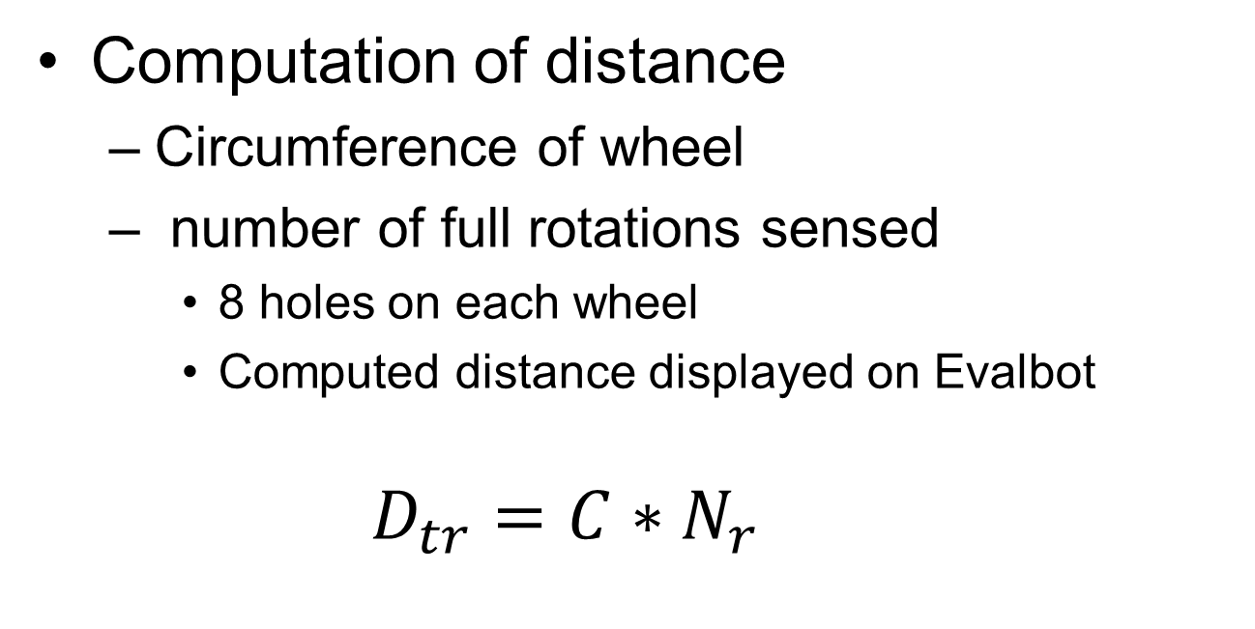
Computation
Computation of distance
Circumference of wheel
number of full rotations sensed
8 holes on each wheel
Computed distance displayed on Evalbot
$$D_{tr}={C∗N}_{r}$$

Slide 11
Recording and Analysis
Record successful distance traveled in small increments
Compare theoretical path against actual
Theoretical: straight edge
Actual: Evalbot’s path
Percentage error
Projected to be very large in first stage.

Slide 12
Design Overview
Flow Charts: order of pseudocode
Created 4 tasks
1) Task_EvalDrive
2) Task_Sched
3) Task_Drive
4) Task_Display

Slide 13
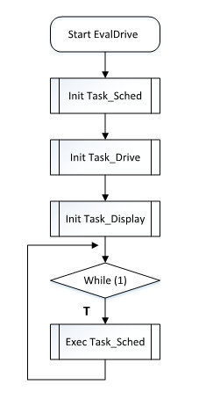
Task_EvalDrive

Slide 14
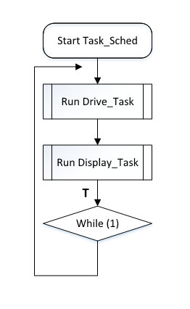
Task_Sched

Slide 15
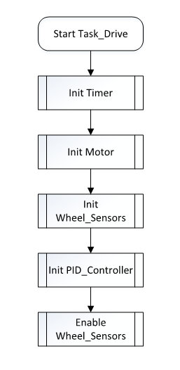
Task_Drive

Slide 16
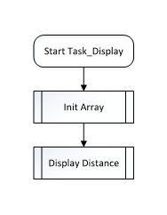
Task_Display

Slide 17
Questions/Suggestions?

